Slide 1
Backtracking
(Chapter 12)

Slide 2
Backtracking
Backtracking
n Queen problem

Slide 3
Backtracking
Suppose you have to make a series of decisions, among various choices, where
You don’t have enough information to know what to choose
Each decision leads to a new set of choices
Some sequence of choices (possibly more than one) may be a solution to your problem
Backtracking is a methodical way of trying out various sequences of decisions, until you find one that “works”

Slide 4
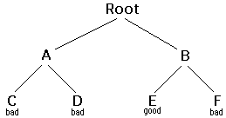
Backtracking
Think of the solutions as being organized in a tree
The root represents initial state before the search begins
Nodes at first level represent first choice
Second… second choice..etc

Slide 5
Backtracking in words
IDEA:
Construct solutions one component at a time
If a partial solution can be developed further without violating constraints:
Choose first legitimate option for the next component
If there is no option for the next component
Backtrack to replace the last component of partial solution

Slide 6
Backtracking – Abstract Example
Starting at Root, your options are A and B. You choose A.
At A, your options are C and D. You choose C.
C is bad. Go back to A.
At A, you have already tried C, and it failed. Try D.
D is bad. Go back to A.
At A, you have no options left to try. Go back to Root.
At Root, you have already tried A. Try B.
At B, your options are E and F. Try E.
E is good. Congratulations!

Slide 7
Backtracking (animation)
dead end
?
dead end
dead end
?
start
?
?
dead end
dead end
?
success!
The tree used to build solutions is called the state-space tree
The nodes are partial solutions
The edges are choices

Slide 8
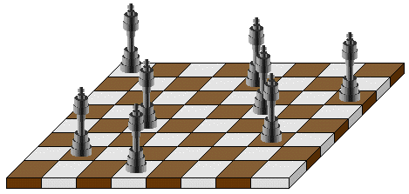
Example: n-Queens Problem
Place n queens on an n-by-n chess board so that no pair of them are in the same row, column or diagonal

Slide 9
Example: 4-Queens
n=4
We can solve it by backtracking
Root is empty board
At level i… put a queen in row i

Slide 10

State-Space Tree of 4-Queens
For any n>3, a solution can be found in linear time
Q
Q
X
X
X
X
X
Q
Q
Q
Q
Q
Q
X
X
X
X
X
X
X
Q
Q
Q
Q
Q
Q
X
X
X
X
X
X
Q
Q
Q
Q
solution

